Slide 1
MuleSoft Demand / Pipeline : 2021
April 14, 2021
Bindu Tuli, Director, PSEG

Slide 2
API Project Pipeline
Project | Demand | Resources
EE-EV | Need to develop around 50+ integrations | 2 Developers are budgeted Need to plan for API Solution Architect
GIS | Exploring if the team can leverage existing APIs; need at least few new integrations to be developed. | Need API developers & API Solution Architects
Project tracking systems | Integration with SAP for WBS & sub-WBS | Need API developers & API Solution Architects
Equipment Mgmt. system | Integration with SAP for General Ledger | Need API developers & API Solution Architects
MWMS | Current integration will be live by May; Enhancements to APIs expected later this year(Effort size - small) Migration to CloudHub | Need resources for CloudHub Migration Need resources for post production support & operations
SPOT | Migration to CloudHub | Need resources for CloudHub Migration Need resources for post production support & operations
Traffic Control | Build integration between SF & SAP SF & Municipality systems | Need API developers & API Solution Architects

Slide 3
API Project Pipeline
Project | Demand | Resources
Enhance Supply Chain Utility | Need support for scoping & initiation | Need API Solution Architect (small effort)
CRM Chat | Migration to CloudHub | Need resources for CloudHub Migration Need resources for post production support & operations
CRM Migration Phase 1 (NJ) - Around June'21 | Remediate defects Migration to CloudHub | Have 2 resources for support till project goes live Need resources for CloudHub Migration Need resources for post production support & operations
CRM Migration Phase 1 (LI) | Remediate defects Migration to CloudHub | Need resources for CloudHub Migration Need resources for post production support & operations
CRM Migration Phase 2(NJ) | Roadmap in progress; No funding | Need API Solution Architect (small effort) Need API developers based on scopes
CRM Migration Phase 2(LI) | Roadmap in progress; No funding | Need API Solution Architect (small effort) Need API developers based on scopes
Asset Health | Potential integration with CMMS Data from sub-station, transformer Data from CMMS to IBM platform | Need API developers & API Solution Architects

Slide 4
Platform Pipeline
Post production support
CloudHub Migration or 4.3 upgrade API changes (80+ APIs)
Operations
Monitoring
Altering
Troubleshooting
4.3 upgrade

Slide 5
Resourcing Model
Iterative & demand based resource scaling
Staff minimal resources to operate CoE
Leverage 25% of the proposed Architect / Developers for initial projects
Depending on the value & need, add more resources to CoE
CoE resources focus in 2021
Platform standards
Platform setup
Technical oversight for projects
CloudHub migration
Production support

Slide 6
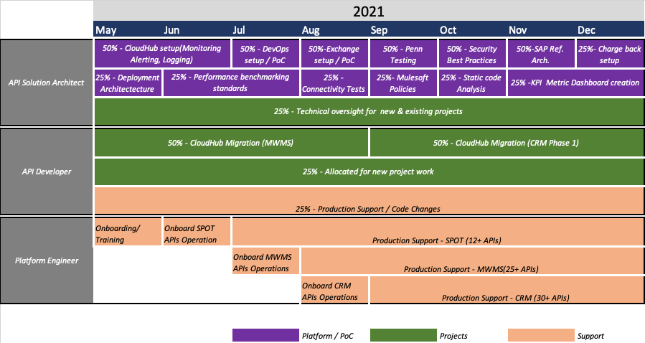
Platform Pipeline

